Slide 1


Equality Through transparency:
PURPOSE
Indiana Online Users Group| October 21st 2016
Collaboration between Academic Libraries and Faculty to Improve Student Success in a Diverse Population
TASK
Maya Hobscheid | Instructional Design Librarian
Marydean Martin Library | Nevada State College
CRITERIA

Slide 2
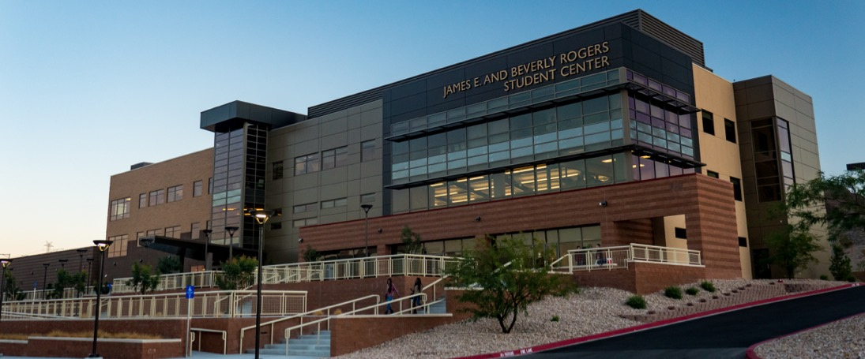
Nevada State College

Slide 3

NSC Student Population
61% are first generation students
50% from culturally diverse backgrounds
A Minority Serving Institution
Emerging Hispanic Serving Institution

Slide 4
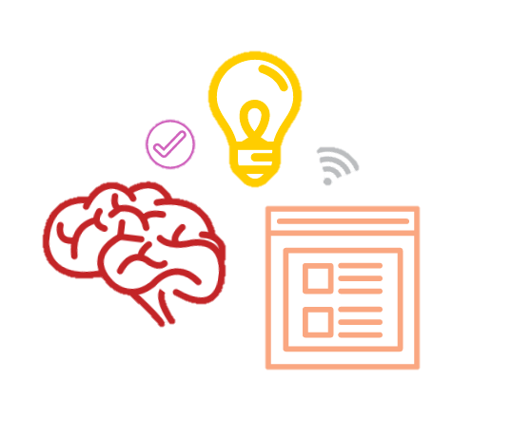
86% of NSC students agree that improving their critical thinking and problem solving skills is an important or very important goal of their college experience.
NSC Student Ithaka Survey

Slide 5

63% of NSC Faculty strongly agree that improving students’ research skills related to locating and evaluating scholarly information is an important educational goal for the courses they teach.
NSC Faculty Ithaka Survey

Slide 6
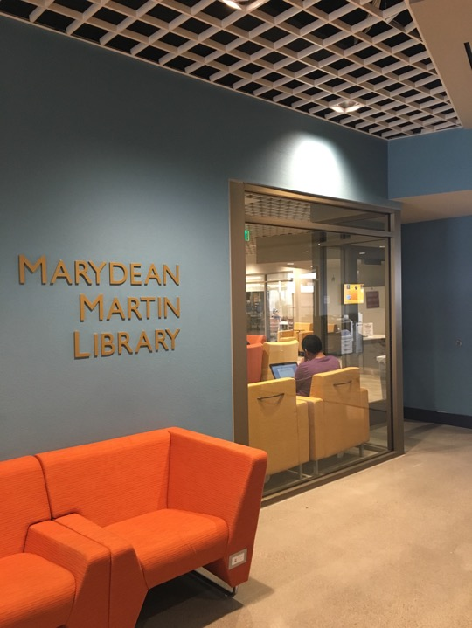
Summer Library Workshop

Slide 7

Transparency in Learning & Teaching
Transparent teaching methods help students understand how and why they are learning course content in particular ways.

Slide 8
Transparency in Learning & Teaching
Skills practiced
Knowledge gained
PURPOSE
What excellence looks like
Criteria provided in advance
CRITERIA
What students will do
How to do it
TASK

Slide 9

Transparency &
Problem-Centered
Learning Project
Copyright © 2014 Mary-Ann Winkelmes.
This work is licensed under a Creative Commons Attribution-NonCommercial-ShareAlike 4.0 International License

Slide 10
The Data

Slide 11
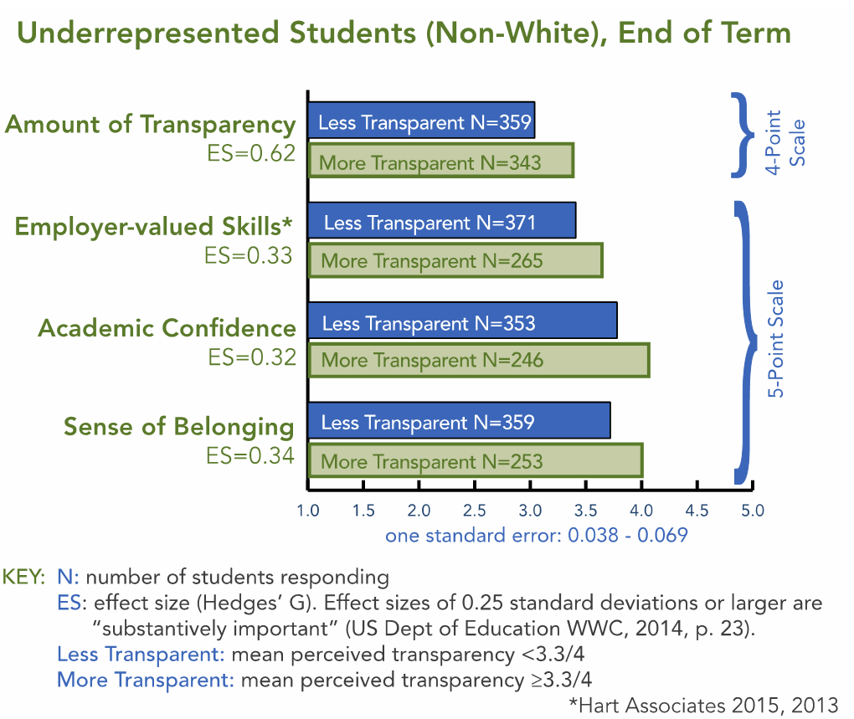
The Data

Slide 12
Summer Library Workshop Outline

Slide 13
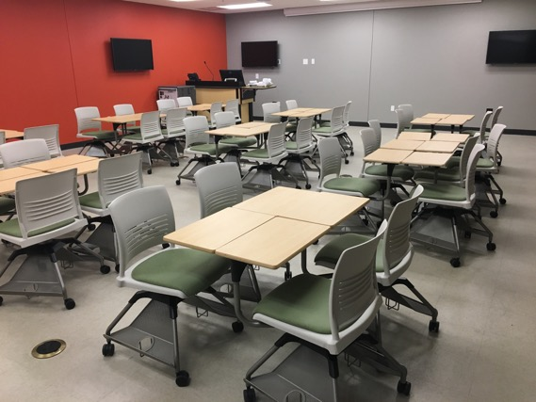
Summer Library Workshop Outline
Introduction to Transparency in Research Assignments
Define the benefits of using the transparent assignment template for research assignment design
Apply transparent design principles to example research assignments

Slide 14




The
Research Process
Developing a Topic
Accessing Information
Evaluating Sources
Communicating Evidence
Citing Sources
Notes:
Listed here are the main steps of the research process. Making these transparent in the purpose of your research assignment can be hugely beneficial to your students.
I am going to go through each one and provide some examples of possible learning outcomes for each step of the research process.

Slide 15


Summer Library Workshop Outline
Defining the Purpose: Learning Outcomes for Research
Understand learning outcomes related to information literacy
Develop or improve information literacy learning outcomes for SLW assignments

Slide 16
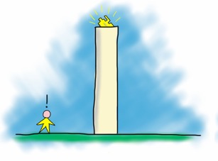
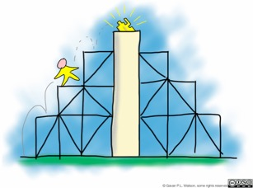
Summer Library Workshop Outline
Defining the Task: The Research Process
Review the research process from a student perspective
Understand library services and resources available to student researchers

Slide 17
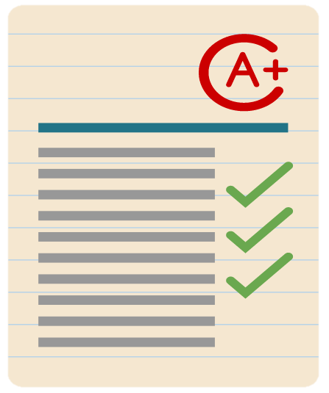
Summer Library Workshop Outline
Defining the Criteria: Assessing Student Research
Apply the Criteria principles of Transparency in Learning and Teaching
Understand strategies for defining criteria of successful research assignments

Slide 18
Summer Library Workshop
“Thank you for a great workshop! This is one of the most worthwhile faculty enrichment activities I have taken part in during my 10 years at NSC.”

Slide 19
Summer Library Workshop
What was the most useful thing you learned at the workshop today?
"Incorporating real outcomes into my project for information literacy. Also, learning about the various resources available to us from the library."

Slide 20
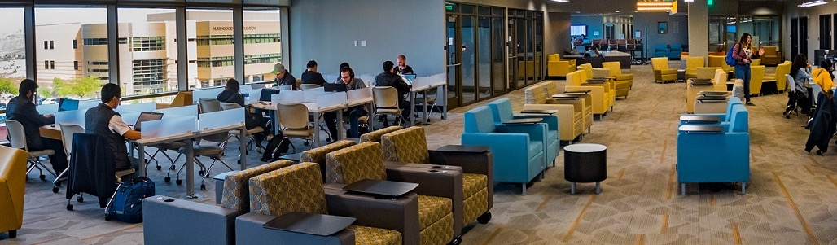
Future Plans

Slide 21
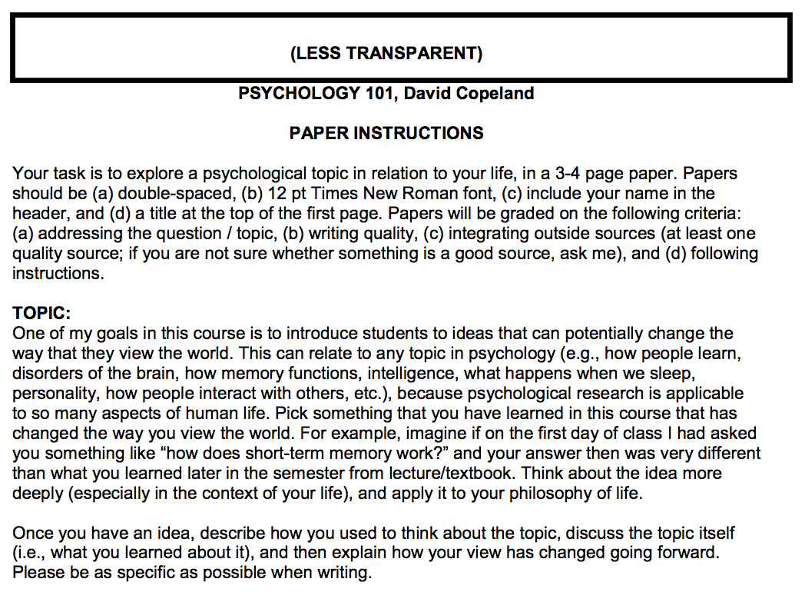
Transparency ACTIVITY
Transparency ACTIVITY
Look at the less transparent Psychology 101 sample assignment:
Can you clearly identify the purpose, task, and criteria?
How could you make the purpose, task, and criteria more transparent?

Slide 22
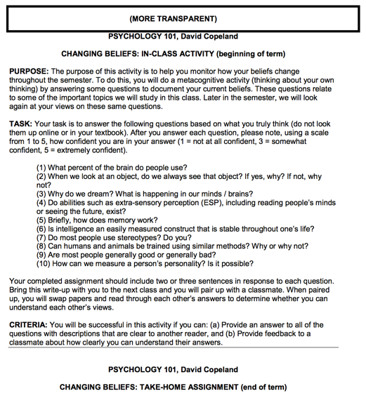
Transparency Activity
Look at the more transparent Psychology 101 sample assignment:
Have the purpose, task, and criteria been clearly identified?
How could you make this assignment even more transparent?

Slide 23
Additional Resources
Association of American Colleges & Universities. (2014, July 31). Information literacy VALUE rubric [Text]. Retrieved from https://www.aacu.org/value/rubrics/information-literacy
Hart Research Associates. (2015). Falling short? College learning and career success. Washington, DC: Association of American Colleges and Universities. Retrieved from https://www.aacu.org/sites/default/files/files/LEAP/2015employerstudentsurvey.pdf
Head, A.J, & Eisenberg, M. (2010). Truth be told: How college students evaluate and use information in the digital age. Project Information Literacy Progress Report. Retrieved from http://projectinfolit.org/images/pdfs/pil_fall2010_survey_fullreport1.pdf
Ithaka S+R. (2014a). Nevada State College faculty survey: Report of findings. Henderson, NV: Nevada State College.
Ithaka S+R. (2014b). Nevada State College student survey: Report of findings. Henderson, NV: Nevada State College.
Nevada State College (2016). Facts & figures. Retrieved from http://nsc.edu/about/facts-and-figures/index.aspx.
Winkelmes, M.-A. (2013). Transparent assignment template. University of Nevada, Las Vegas. Retrieved from https://www.unlv.edu/sites/default/files/page_files/27/Provost-Faculty-TransparentAssgntTemplate-2016.pdf
Winkelmes, M.-A. (2015). Transparency in Learning and Teaching Project. Retrieved from http://www.unlv.edu/provost/teachingandlearning
Winkelmes, M.-A., Bernacki, M., Butler, J., Zochowski, M., Golanics, J., & Weavil, K. H. (2016). A teaching intervention that increases underserved college students’ success. Peer Review, 16(1/2). Retrieved from https://www.aacu.org/peerreview/2016/winterspring/Winkelmes

