Slide 1
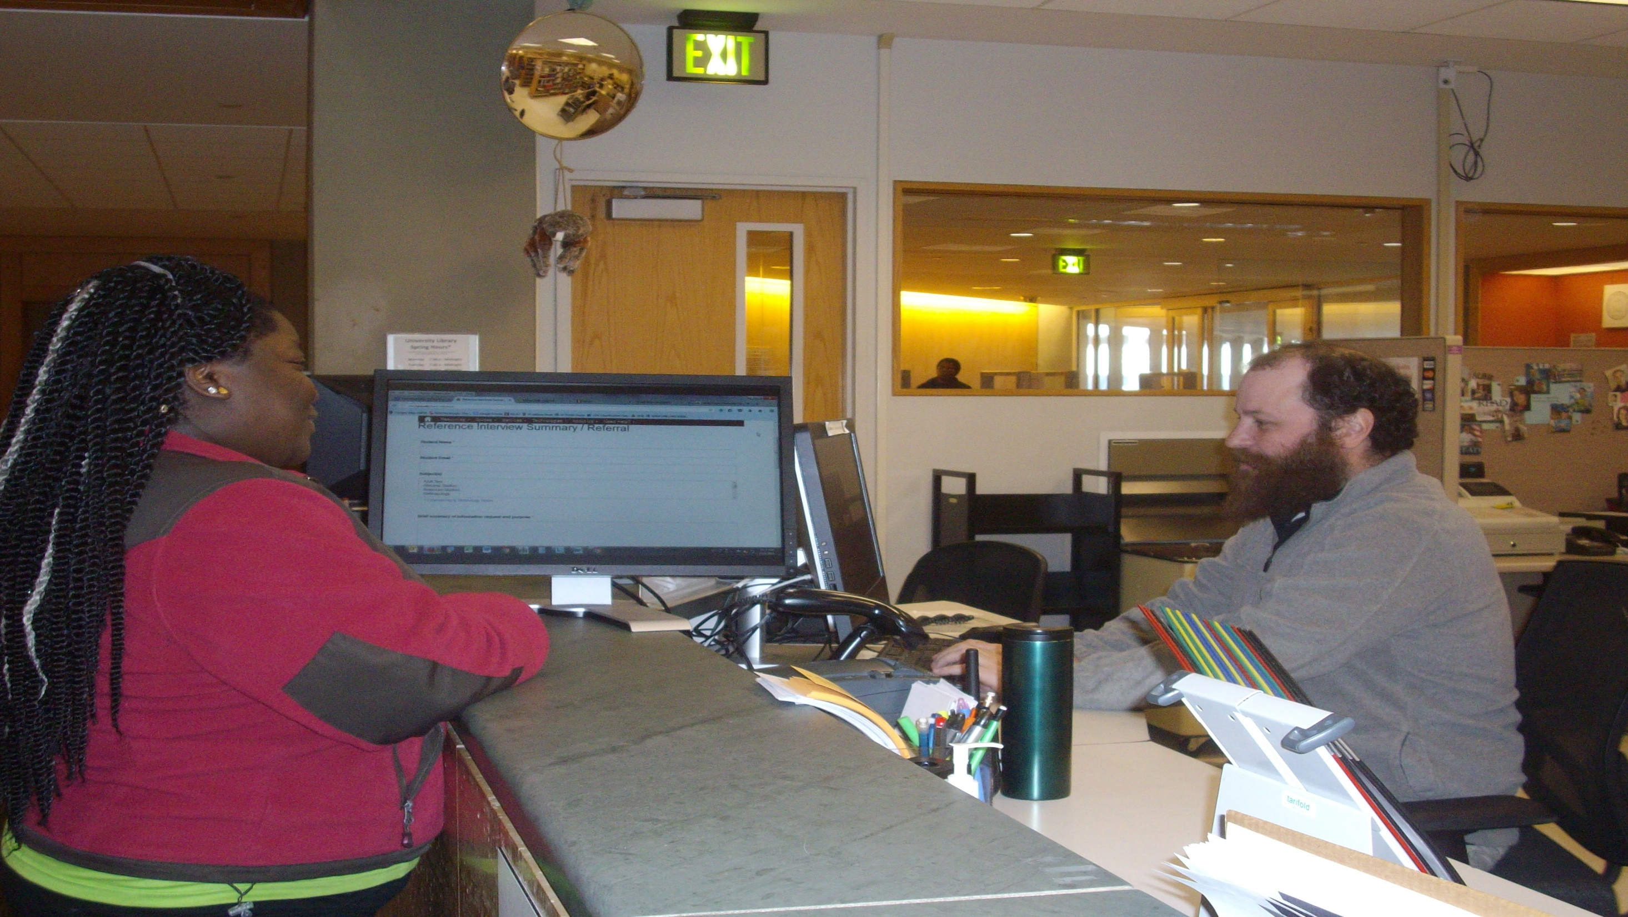
Time to Ref-Form
Rethinking connections between patrons, library staff, and resources using an online reference referral form

Slide 2
Current Climate
Transition to Single Service Desk
Fewer questions at “ref desk”
Changing nature of questions less reliance on subject expertise
Tiered referral model
Notes:
The Service & Information desk at IUPUI is a single service location for reference, circulation and technology assistance.
We’ve operated in this model since 2013, when we merged the reference desk with the circulation desk. It is now staffed mainly by graduate students and paraprofessionals. The main motivating factor for this transition was the continuing decline of traditional reference questions at the physical reference desk. Subject librarians were also less available to staff the desk since they were spending more time offering bibliographic instruction in the classroom. At the same time, we intended/hoped to reduce confusion for students unsure about which desk to approach for help.
In this climate most of our reference-related questions involve introducing students to resources and search strategies. When more expertise is needed from a subject liaison we train our staff to look for the indicators that it’s appropriate to refer – this has traditionally meant displaying a libguide with contact information, as well as handing out a business card.
However, since January of 2016 we have transitioned to the online referral form which we’ll display in detail today.

Slide 3
Referral Methods
Old
New
Notes:
One of the major difficulties with our traditional referral method was its passive approach - it left us in the dark about whether or not students were using the information we gave them to seek out a librarian and continue their research. There was no real takeaway with this method, besides a business card.
A detrimental side effect of this ambiguity, which has existed longer than the single-service model, is that feedback through various channels indicated that librarians were skeptical about whether the service desk was giving out their contact information. Obviously this skepticism doesn’t help to foster a collaborative and open relationship between librarians and our staff at the Service & Information desk.
This was our motivation for seeking a change to our referral model, and why we developed an online form instead.

Slide 4
Motivations
Make more concrete connections between students and librarians
Create more active student engagement in the reference interview
Notes:
Our main objective was to create a way to make more concrete connections between students and librarians, to ensure students are receiving the assistance that will benefit them the most – and we believe the form meets this objective because it removes the onus of contact from the student (as in our old method), and places it with the librarian.
We also believe the form is helping improve the reference interview, both for the student and for our staff.

Slide 5
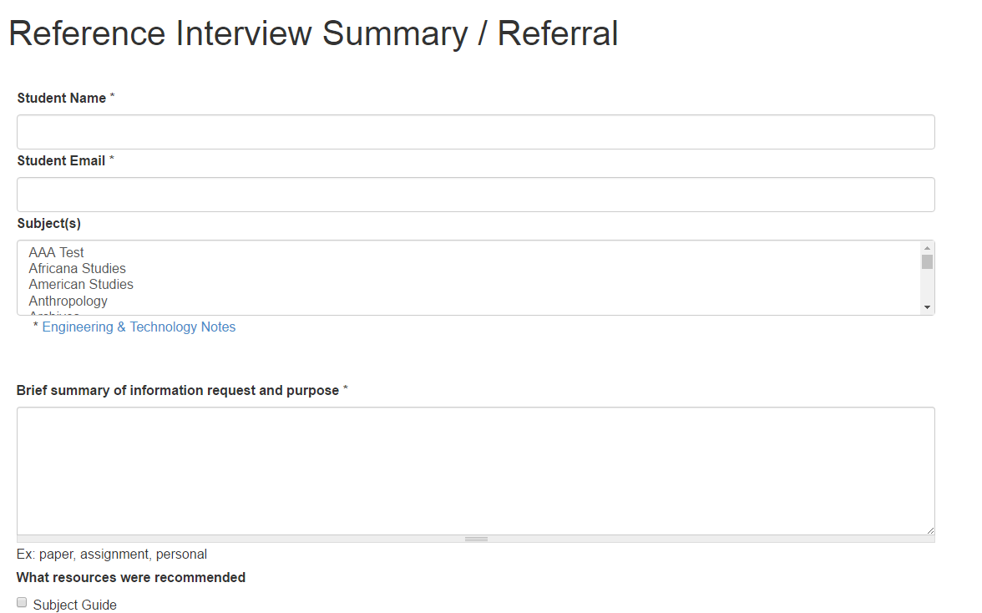
The Form
Notes:
The form allows our staff to help document the research question, as well as the information that we give to the student.
It captures a summary of their research question, what subject and class is the assignment for, and what year the student is in school (undergraduate or graduate). The form allows us to link to subject guides that we demonstrate, as well as the catalog or some common multidisciplinary databases. A second box provides space to put instructions for searching, keywords and search terms, as well as links to other resources such as campus departments or information, professional organizations, or government websites.
Lastly, the form has a selection at the bottom that clearly indicates whether or not the student wants to be contacted by a librarian, and so explicitly directs the librarian to follow up.
In each of these form elements, the student is collaborating with the staff person to brainstorm search strategies and search terms, define the research question, and select the best resources.

Slide 6
Generated Emails-Student
Notes:
Once the form is submitted, the student receives an email that summarizes the reference interview and provides all of the necessary information to recreate the search process wherever they choose.

Slide 7
Generated Emails--Librarian
Notes:
When a subject guide is selected on the form, the librarian for that subject receives the same email. This lets them see what we discussed and showed the student, and lets them determine further search strategies, based on what has already been discussed.

Slide 8
Benefits for Students
The referral form makes it easier to
Use the resources demonstrated
Library resources are not always intuitive to use or easy to find
Recreate and better understand the research process
Sources are easier to use when linked, and are
a better alternative to Google
Notes:
Ultimately we hope that our referral form will improve our student’s experience with our staff, our resources, and our service. We’ve trained our students to look for openings in the conversation to use the form and fill it out – with the student’s participation. It is completely voluntary. But those students that opt in are helping decide which resources they want included and emailed to them, and participating with our staff to make sure useful keywords, search terms, and tips are included in the form.
This is more engaging for the student than speaking at them, because they are more involved.
Even if the student decides they don’t wish to be contacted by a librarian, we think the overall experience of the reference interview has been improved for the student. A succinct summary, with links to resources, gives them the ability to more easily recreate what they’ve learned during the interview on their own time. This, in effect, extends our service beyond the desk and hopefully makes our interaction with the student have greater impact.

Slide 9
Benefits for Librarians
Referral Form keeps them connected
What types of questions are received at the desk?
Which courses/classes may benefit from instruction?
Notes:
We had the librarians in mind as well, and we think the form has a number of benefits for them. Primarily, the form now keeps librarians better connected and informed about what kinds of research questions are being asked at the desk.
More, if the librarian is asked to contact the student, they can have valuable context about the nature of the research inquiry - such as what sources were already introduced by the desk staff, what keywords and search words were used. This means the librarian doesn’t have to spend time introducing a resource, but can use their expertise to refine or enhance a search inquiry where the student is already familiar.
Librarians can also get a better sense of how their own work in the classroom may be improved, or find potential new instructors to work with. For example, if we capture information about what course the student is working on, or who is the instructor, the librarian may be able to discern a pattern if repeated course assignments show up on the form. They may be able to identify an instructor whose students could benefit from in-class instruction. Additionally, if they’ve already taught inside a classroom and those students continue to seek additional help at the Service & Information desk, the librarian will have a better sense of how well students are retaining knowledge during their instruction sessions and can potential find new ways to reach them instead.

Slide 10
Benefits for Staff
Helps us learn from librarians
Serves as a model of the reference interview
Makes us mindful of available resources
Users may refer their friends
Users may return for help with additional research projects
Notes:
We think the form layout mimics a successful reference interview, and that this will help our staff logically and fluently move from one question to the next.
From a marketing perspective, the email takeaway from the referral form may resonate with students, so much so that they create more traffic at the desk by telling their friends and classmates.
The form also has the potential to allow our staff to learn and improve, especially with the help of librarians. When a librarian receives the email, they can identify whether or not our staff recommended the best and most appropriate resources and make suggestions in the event that we didn’t.

Slide 11
Design
Notes:
When we started to envision how it would work, Mindy suggested it would make the most sense if it would follow the interview process, and that would allow it to work more fluidly in the interaction. So we began by sketching out the elements we wanted to include, and arranging them to follow the interview process.

Slide 12
Stakeholders
Input from student employees
Input from liaison librarians
Input from tech support
Reference Interview Summary/Referral
Notes:
As we were designing the form, we knew it would be important to get input and feedback from everyone that would be using the form. We used our sketch to show to our students, and see if there were elements we had overlooked, or neglected to include. We also wanted to make sure that they wouldn’t have difficulty using it during a reference interview.
We then worked with our web design team to figure out how to create an aesthetic and feel that was easy to use as well as to view. Finally, we showed the form to a group of librarians who gave us additional suggestions, such as the ‘opt in’ button to explicitly state whether they wanted to be contacted by a librarian.

Slide 13
Assessment
Surveys
Analysis of form submissions
Librarian feedback
How do we know if it is working?
Notes:
Moving forward, we of course recognize the need to hear from the students – the ones we hope will benefit most from the form. Essentially, we want to know if the form works for them, as we intended.
We are currently designing surveys that we can send to students to gauge whether or not the form was helpful to them to find, organize, and think about their research. We’ll also be sending a survey to our librarians, to find out if the form was useful to them – did it make the connection with students easier for them? Was the information accurate, and did it improve their consultations in some way? Once we hear back from these groups we can make any necessary changes to improve the functionality of the form.
The Spring 2016 semester was our first semester to use the form, and we have some data about it’s use – this is the first time that we’ve been able to gauge the number of consultations that directly resulted from a referral from the Service & Information desk. Previously we knew how many business cards we had given out but we’ve never known definitively how often a librarian connected with students as a result.
Since January, the form was sent out nearly 50 times. Of those, more than 30 students asked to be contacted by a librarian. These numbers are meager, but we’re hoping to grow those numbers in the fall as our staff becomes more comfortable using the form, and as word spreads about it.

Slide 14
Referral Form @ Your Library
Do you have a similar form at your library? What might a form or similar tool look like at your institution? Discuss with a partner or in a small group.

Slide 15
Thank you!
Paul Moffett, Access Services Team Leader pamoffet@iupui.edu
Mindy Cooper, Reference Associate
mmcooper@iupui.edu
IUPUI University Library
755 W. Michigan Street, Indpls, IN 46202

